Slide 1
Queues
CS 201, Summer 2013

Slide 2
ADDITIONAL READING
Queues
  https://en.wikipedia.org/wiki/Queue_(abstract_data_type)
  http://www.cprogramming.com/tutorial/computersciencetheory/queue.html

Slide 3
Data Structures
A Queue is another type of data-structure, which can be implemented with a Linked List structure.
A Queue restricts how you can access elements of the List.
With a Queue, you can only access the first item in the list (which was added first). You cannot get to later elements until the First item has been popped off the Queue.

Slide 4
Data Structures
Queues are “FIFO”
  First In First Out
  Items added to the list last are accessible last.
  Just like Queueing-Up (ie, getting in a line) at the bank or store.
Stacks are “FILO”
  First In Last Out

Slide 5
Data Structures
The Standard Template Library in C++ contains a queue container:
http://www.cplusplus.com/reference/queue/queue/
Has functionality:
  push
  pop
  front
  size

Slide 6
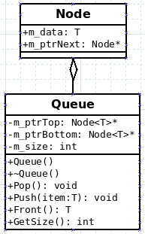
Implementing a Queue in C++...
A Queue has a pointer to a Node (or two), and each Node points to the next item in the list.
Here, we will store a pointer to the Top and Bottom Nodes, so we can easily access the Top.
Bottom is the same as First, and Top is the same as Last.
You could rename these if you want. I just modified the Stack class to get this.

Slide 7
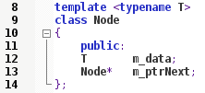
Implementing a Queue in C++
The Node
The Node will contain data, which in this case is an undetermined type T.
The Node also contains a pointer to the next Node in the list.

Slide 8
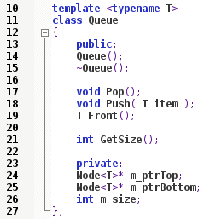
Implementing a Queue in C++
The Queue
The Queue contains two Node pointers (remember to add the <T>!) and the size of the Queue.
It also contains functionality for
  Constructor
  Destructor
  Pop
  Push
  Front
  Getting the Size

Slide 9

Implementing a Queue in C++
Queue Constructor
Within the Constructor, we set the pointers equal to NULL (which is equal to 0 in C++98), and set the size equal to 0.
I am using an initializer list here.

Slide 10
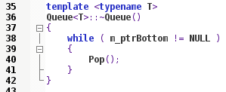
Implementing a Queue in C++
Queue Destructor
Within the Destructor, we will want to Pop every item off the Stack, while there are still items to pop.
We will know the Stack is empty, when the first item pointer (m_ptrBottom) is NULL.
  When we remove data, we will set the appropriate pointer to NULL.

Slide 11
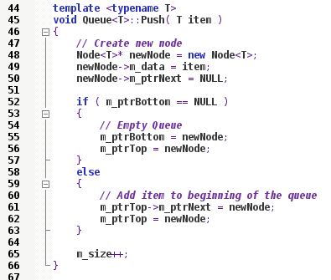
Implementing a Queue in C++
Queue Push
When we Push a new item, we will need to create a new Node. This isn't a Dynamic Array, but it is a Dynamically allocated variable.
Then, if the Queue is empty we will set the Top and Bottom pointers to point to our new Node.
If there is already elements in our Queue, this new Node becomes the Front of our Queue.

Slide 12
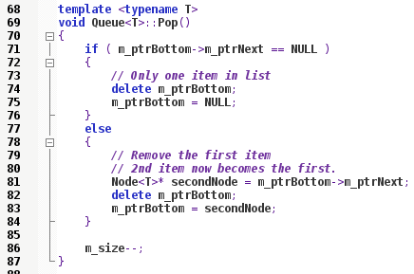
Implementing a Queue in C++
Queue Pop
When we Pop an item off the list, if the Queue only has one item, we delete it and reset the Bottom pointer to NULL.
Otherwise, if there is more than one item in the list the 2nd node in the list will become the first.

Slide 13
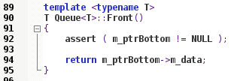
Implementing a Queue in C++
Queue Front
When we want to get the First item from the list, we simply return the data stored in the Bottom node via “Front” function.

Slide 14

Implementing a Queue in C++
Queue GetSize
GetSize just returns our m_size variable.
GetSize just returns our m_size variable.

Slide 15
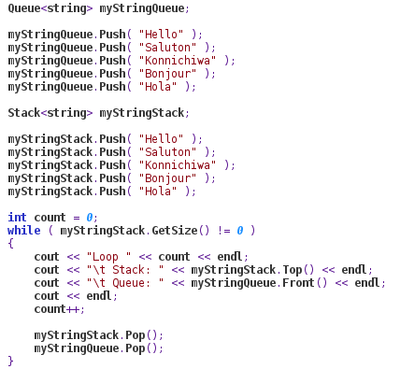
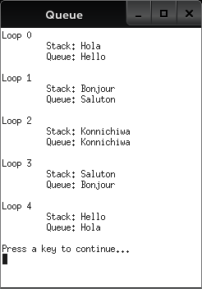
Implementing a Queue in C++
Queue GetSize
We can use Stacks and Queues in similar ways, and notice the different output.

Slide 16
References

